Slide 1
Hacker Techniques, Tools, and Incident Handling
Chapter 12
Linux and Penetration Testing

Slide 2
Learning Objective
Explain the history and current state of hacking and penetration testing, including ethical and legal implications.

Slide 3
Key Concepts
Basic concepts of Linux
Kali Linux for hacking or penetration testing
Benefits of using live distributions

Slide 4
Linux
Open source
Open source means source code is available to anyone who wants to peruse it
Free means “no charge”
Has a command-line interface and a graphical user interface (GUI)
Source code available per the General Public License (GPL)
Kernel is core component of operating system

Slide 5
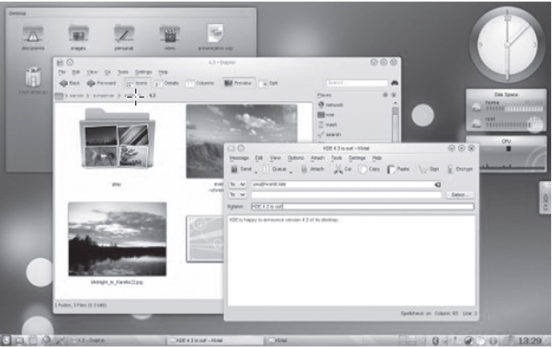
Linux KDE Desktop

Slide 6
Common Linux Distributions
Ubuntu
Arch Linux
CentOS
Elementary
Fedora
Manjaro
Debian
openSUSE
More …
Notes:
CentOS (Community Enterprise Operating System)

Slide 7
Introducing Kali Linux
Built on Debian distribution
Designed for hacking or penetration of target networks and systems
Used by IT and security professionals to assess security of target environments
Not designed as a desktop replacement OS
Kali Linux

Slide 8
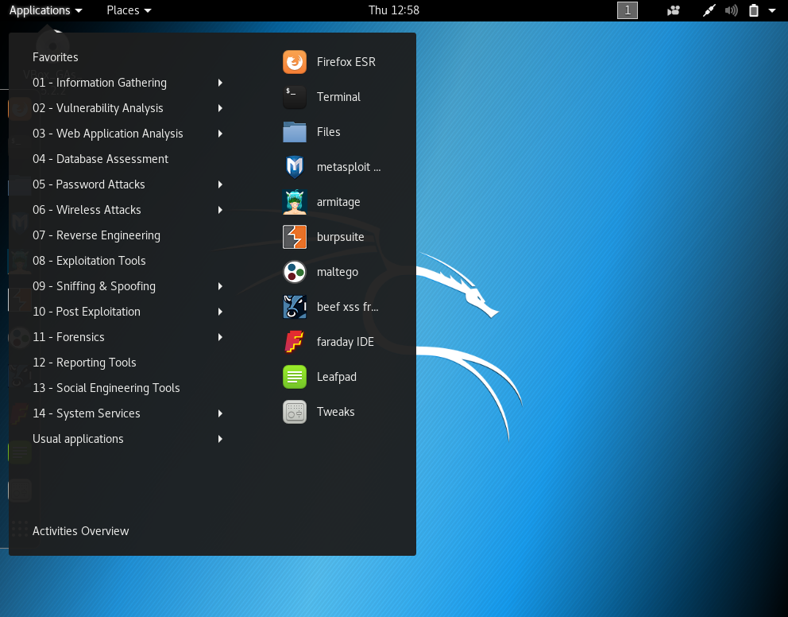
Kali Desktop Applications Menu

Slide 9
Basics of Working with Linux (Cont.)
Interface
Can operate from command-line interface or GUI
Navigation
Linux directories are annotated with “/”
Design
Awareness of built-in directories allows administrators to monitor known expected files and directories
Drives and partitions referenced with a series of filenames: /dev/hda1/file

Slide 10
Basics of Working with Linux (Cont.)
Vital to understand terminal windows and frequently used commands
Requires knowledge of filenames, directory names, and commands that are case sensitive
Commands share a common form

Slide 11
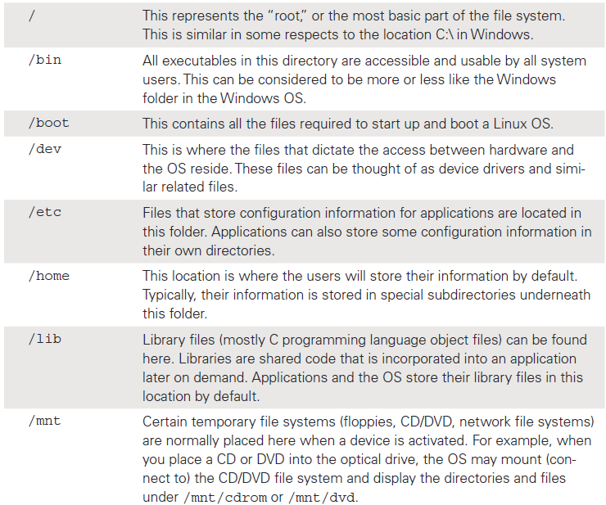
Vital Directories in Linux Filesystem

Slide 12
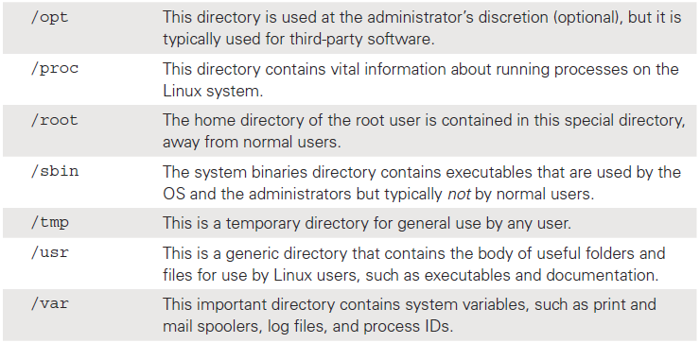
Vital Directories in Linux Filesystem (Cont.)

Slide 13
Basic Command Structure of Linux
command <option(s)><argument(s)>
Name of a command generally consists of lowercase letters and digits
Options modify the way a command works.
Example: The -a option of ls command generates command output that lists “hidden” files as well as normal files

Slide 14
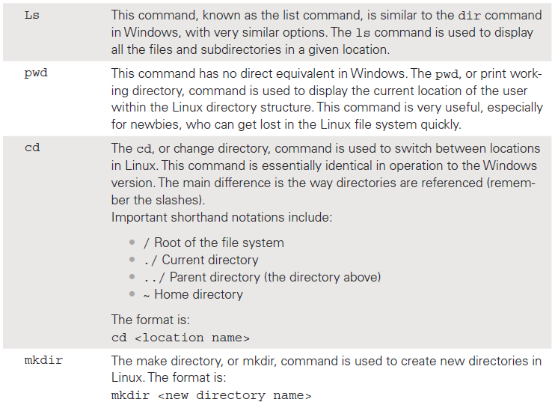
Linux Commands

Slide 15
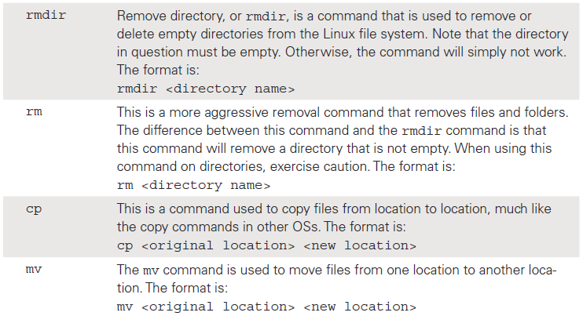
Linux Commands (Cont.)

Slide 16
Live CD/DVD
Contains a complete and bootable operating system
Does not alter the existing operating system
Provides the ability to return the system to the state it was in prior to using live distribution
Boot from the live medium and use the OS.
When you’re finished, shut down the OS, eject the medium, and reboot. You are back where you started.

Slide 17
Live CD/DVD: Uses
Installing Linux on a new system
Testing new software
Evaluating hardware configurations
Repairing damaged systems
Providing guest systems
Providing portable systems
Cracking passwords
Stealing passwords
Resetting passwords
Conducting penetration testing
Multibooting
Performing forensic investigations
Providing a secure, unalterable OS
Setting up kiosks
Creating persistent desktops

Slide 18
Special-Purpose Live CDs/DVDs
Kali
Password reset
Rescue disc
Firewall

Slide 19
Virtual Machines (VMs)
Most security professionals use Kali as a VM
VMs provide ability to run on a host computer without installing Kali or boot from alternative media
VMs allow you to load Kali, examine a running computer, pause it, and then restart at will
Linux VM provides unparalleled flexibility and software availability

Slide 20
Summary
Basic concepts of Linux
Kali Linux for hacking or penetration testing
Benefits of using live distributions

